Slide 1
Sentiment Analysis

Slide 2
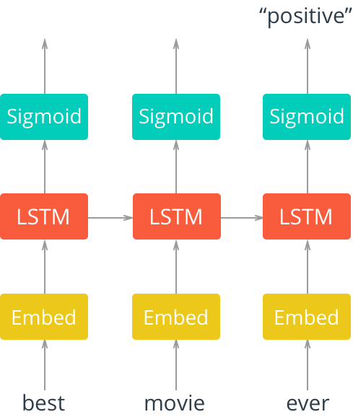
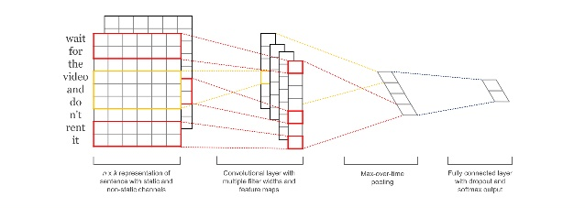
Practice 1
Sentiment Analysis
The task of identifying Positive or Negative opinions in text
Deep Learning can be able to analyze text

Slide 3
Practice 1: Sentiment Analysis
Sentiment Analysis
Task : Sentiment Classification (pos/neg)
Data : imdb dataset
Model : DNN, CNN, RNN..

Slide 4
Practice 1: Sentiment Analysis
Data Set
IMDB dataset
Sentiment Analysis of Movie Review
Pos/Neg
Total number
Train : Pos – 15,000 sentence / Neg – 15,000 sentence
Test : Pos – 15,000 sentence / Neg – 15,000 sentence
Vocabulary : 10,000
Example)
Pos) Although I didn't like Stanley & Iris tremendously as a film, I did admire the acting. Jane Fonda and Robert De Niro are great in this movie. I haven't always been a fan of Fonda's work but here she is delicate and strong at the same time. De Niro has the ability to make every role he portrays into acting gold. He gives a great performance in this film and there is a great scene where he has to take his father to a home for elderly people because he can't care for him anymore that will break your heart. I wouldn't really recommend this film as a great cinematic entertainment, but I will say you won't see much bette acting anywhere. Neg) This fanciful horror flick has Vincent Price playing a mad magician that realizes his vocational talents have been sold to another. He devise ways of avenging all those that have wronged him. His master scheme seems to back fire on him. Price is a little below par compared to his masterpieces, but is still the only reason to watch this thriller. Supporting cast includes Patrick O'Neal, Mary Murphy, Eva Gabor and Jay Novello.

Slide 5
Practice 1: Sentiment Analysis
Deep Neural Networks
Today
I
am
Pos(1)
.
.
.
.
.
.
Neg(0)
very
happy
Input Layer
Hidden Layer
Output Layer

Slide 6
Practice 1: Sentiment Analysis
Step
Preprocessing
Build Model
Train Model

Slide 7
Practice 1: Sentiment Analysis
Preprocessing
Code (imdb_loader.py)
import numpy as np class text_data(object): def __init__(self, path="../../dataset", max_vocab=20000, max_len=100, end_token="<eos>"): self.train_pt, self.val_pt, self.test_pt = 0, 0, 0 self.path = path self.max_len = max_len self.max_vocab = max_vocab self.w2idx = {end_token: 0, "<unk>": 1} self.train_ids, self.train_len, self.train_label = self.files_to_ids(path + "/aclImdb/train/") self.test_ids, self.test_len, self.test_label = self.files_to_ids(path + "/aclImdb/test/") self.vocab_size = len(self.w2idx) self.train_size = len(self.train_ids) self.test_size = len(self.test_ids) self.idx2w = {} for word in self.w2idx: self.idx2w[self.w2idx[word]] = word def get_w2idx(self, word): return 1 if word not in self.w2idx else self.w2idx[word]

Slide 8
Practice 1: Sentiment Analysis
Preprocessing
Code (imdb_loader.py)
/pos : positive sentence data
/neg : negative sentence data
def files_to_ids(self, path): pos_list = os.listdir(path + "/pos") neg_list = os.listdir(path + "/neg") size = len(pos_list) lines = [] for i in range(size): with open(path + "/neg/" + neg_list[i], "r", encoding='UTF-8') as fin: lines.append(fin.readline()) with open(path + "/pos/" + pos_list[i], "r", encoding='UTF-8') as fin: lines.append(fin.readline())

Slide 9
Practice 1: Sentiment Analysis
Preprocessing
Code (imdb_loader.py)
Define Dictionary (vocab size : 20000) in Train Time
if "train" in path: cnt = {} for line in lines: for word in line.split(): if word in cnt: cnt[word] += 1 else: cnt[word] = 1 cnt_sort = sorted(cnt.items(), key=lambda cnt:cnt[1], reverse=True) for word, count in cnt_sort: self.w2idx[word] = len(self.w2idx) if self.w2idx == self.max_vocab: break length, ids, label = [], [], []

Slide 10
Practice 1: Sentiment Analysis
Preprocessing
Code (imdb_loader.py)
for num, line in enumerate(lines): id = np.zeros(self.max_len, dtype=np.int32) line += " <eos>" words = line.split() for i, word in enumerate(words): if i == self.max_len: break if word not in self.w2idx and len(self.w2idx) < self.max_vocab: self.w2idx[word] = len(self.w2idx) id[i] = self.get_w2idx(word) ids.append(id) length.append(i) label.append(num % 2) return np.array(ids), np.array(length), np.array(label)

Slide 11
Practice 1: Sentiment Analysis
Model
Setup Layers (DNN)
Make Loss and Optimization
Train Model

Slide 12
Practice 1: Sentiment Analysis
Setup Layer (Model)
Code
example
K번째 문장에서 쓰이는 단어를 count하기위해 index 저장
class Model(object): def __init__(self, max_len=200, emb_dim=128, hidden_dim=128, vocab_size=10000, class_size=2, use_clip=True, learning_rate=0.01, end_token="<eos>"):
… self.vocab_size = vocab_size self.class_size = 2 … self.ind = tf.placeholder(dtype=tf.int32, shape=(None, 2)) self.val = tf.placeholder(dtype=tf.float32, shape=(None, )) self.y = tf.placeholder(dtype=tf.int32, shape=(None, )) # Embedding self.batch_size = tf.shape(self.y)[0]
ID 13 : I go to school
Index : [13, 17(i)], [13, 5(go)]…
13
17
bow : [0 0 0 0…1…1…0]
value : 1.0, 1.0,…

Slide 13
Practice 1: Sentiment Analysis
Setup Layer (Model)
Code
scatter_nd : 해당 index에 value를 더해라!
Bow에는 문장에 쓰인 단어가 Count됨
def build_model(self): bow = tf.zeros((self.batch_size, self.vocab_size), dtype=tf.float32) # bow vector 생성 bow += tf.scatter_nd(self.ind, self.val, [self.batch_size, self.vocab_size]) W1 = self.get_var(name="W1", shape=[self.vocab_size, 128], dtype=tf.float32) b1 = self.get_var(name="b1", shape=[128], dtype=tf.float32) layer_1 = tf.nn.tanh(tf.matmul(bow, W1) + b1) W2 = self.get_var(name="W2", shape=[128, 128], dtype=tf.float32) b2 = self.get_var(name="b2", shape=[128], dtype=tf.float32) layer_2 = tf.nn.tanh(tf.matmul(layer_1, W2) + b2) out_W = self.get_var(name="out_W", shape=[128, self.class_size]) out_b = self.get_var(name="out_b", shape=[self.class_size]) self.out = tf.nn.softmax(tf.matmul(layer_2, out_W) + out_b) self.out_label = tf.argmax(self.out, 1)

Slide 14
Practice 1: Sentiment Analysis
Build Loss (Model)
Code
Build Optimizer (Model)
Code
def build_loss(self): self.cross_entropy = -tf.reduce_sum( tf.one_hot(tf.to_int32(tf.reshape(self.y, [-1])), self.class_size, 1.0, 0.0) * tf.log(tf.clip_by_value(tf.reshape(self.out, [-1, self.class_size]), 1e-20, 1.0)), 1) self.loss = tf.reduce_mean(self.cross_entropy)
def build_opt(self): # define optimizer optimizer = tf.train.AdamOptimizer(learning_rate=self.learning_rate) grad, var = zip(*optimizer.compute_gradients(self.loss))
# gradient clipping def clipped_grad(grad): return [None if g is None else tf.clip_by_norm(g, 2.5) for g in grad] if self.use_clip: grad = clipped_grad(grad) self.update = optimizer.apply_gradients(zip(grad, var))

Slide 15
Practice 1: Sentiment Analysis
Train (Model)
Code
# 0: neg, 1: pos avg_loss, it_cnt, same = 0, 0, .0 it_log, it_test, it_save, it_sample = 10, 100, 1000, 100 start_time = time.time() for it in range(0, 10000): train_ids, length, label = data.get_train(BATCH_SIZE) val, ind = [], [] for i, ids in enumerate(train_ids): for j in range(length[i]): ind.append([i, ids[j]]) val.append(1.0) loss, _, out = sess.run([model.loss, model.update, model.out_label], feed_dict={model.ind: ind, model.val: val, model.y: label}) for i, o in enumerate(out): if o == i % 2: same += 1 avg_loss += loss it_cnt += 1

Slide 16
Practice 1: Sentiment Analysis
Result
Code
if it % it_log == 0: print(" it: {:4d} | loss: {:.3f} | acc: {:.3f} - {:.2f}s".format( it, avg_loss / it_cnt, same/BATCH_SIZE/it_log, time.time() - start_time)) avg_loss, it_cnt, same = 0, 0, .0 if it % it_test == 0 and it > 0: test_model() if it % it_save == 0 and it > 0: model.save(sess)

Slide 17
Practice 1: Sentiment Analysis
Result
Code
it: 3910 | loss: 0.123 | acc: 0.970 - 166.07s
it: 3920 | loss: 0.024 | acc: 0.990 - 166.45s
it: 3930 | loss: 0.027 | acc: 0.990 - 166.83s
it: 3940 | loss: 0.281 | acc: 0.930 - 167.21s
it: 3950 | loss: 0.053 | acc: 0.990 - 167.59s
it: 3960 | loss: 0.009 | acc: 1.000 - 167.97s
it: 3970 | loss: 0.204 | acc: 0.950 - 168.35s
it: 3980 | loss: 0.098 | acc: 0.970 - 168.73s
it: 3990 | loss: 0.040 | acc: 0.980 - 169.11s
it: 4000 | loss: 0.088 | acc: 0.970 - 169.50s

Slide 18
Practice 1: Sentiment Analysis
Convolutional Neural Networks
Pos(1)
Neg(0)

Slide 19
Practice 1: Sentiment Analysis
Model
Add Embedding Layer
Setup Layers (CNN)
Make Loss and Optimization
Train Model

Slide 20
Practice 1: Sentiment Analysis
Embedding Layer (Model)
Code
Bag-Of-Word를 사용할 수도 있고, Embedding Layer를 추가할수도 있음
# Embedding self.emb_W = self.get_var(name='emb_W', shape=[self.vocab_size, self.emb_dim]) self.batch_size = tf.shape(self.x)[0] self.x_emb = tf.nn.embedding_lookup(self.emb_W, tf.concat([self.x[:, :-1], tf.ones([self.batch_size, 1], dtype=tf.int32)], 1))

Slide 21
Practice 1: Sentiment Analysis
Setup Layer (Model)
Code
def build_model(self): # Dimension change for conv net x_emb_4d = tf.expand_dims(self.x_emb, -1) # Create a convolution + maxpool layer for each filter size pooled_outputs = [] for filter_size, filter_num in zip(self.filter_sizes, self.filter_nums): # Seperated name scope for variables (W, b) for each filters with tf.name_scope("conv-maxpool-%s" % filter_size): # Convolution Layer filter_shape = [filter_size, self.emb_dim, 1, filter_num] W = tf.Variable(tf.truncated_normal(filter_shape, stddev=0.1), name="W") b = tf.Variable(tf.constant(0.1, shape=[filter_num]), name="b") # Apply nonlinearity conv = tf.nn.conv2d(x_emb_4d, W, strides=[1, 1, 1, 1], padding="VALID", name="conv") h = self.leaky_relu(conv + b) # Maxpooling over the outputs pooled = tf.nn.max_pool(h, ksize=[1, self.max_len - filter_size + 1, 1, 1], strides=[1, 1, 1, 1], padding='VALID', name="pool") pooled_outputs.append(pooled)

Slide 22
Practice 1: Sentiment Analysis
Setup Layer (Model)
Code
# Combine all the pooled features num_filters_total = sum(self.filter_nums) h_pool = tf.concat(pooled_outputs, 3) self.h_pool_flat = tf.reshape(h_pool, [-1, num_filters_total]) self.h_drop = tf.nn.dropout(self.h_pool_flat, keep_prob=self.keep_prob) out_W = self.get_var(name="out_W", shape=[num_filters_total, self.class_size]) out_b = self.get_var(name="out_b", shape=[self.class_size]) self.out = tf.nn.softmax(tf.matmul(self.h_drop, out_W) + out_b) self.out_label = tf.argmax(self.out, 1)

Slide 23
Practice 1: Sentiment Analysis
Result
Code
it: 3910 | loss: 0.060 | acc: 0.909 - 52.15s
it: 3920 | loss: 0.094 | acc: 0.984 - 52.24s
it: 3930 | loss: 0.072 | acc: 0.988 - 52.33s
it: 3940 | loss: 0.069 | acc: 0.984 - 52.42s
it: 3950 | loss: 0.194 | acc: 0.963 - 52.52s
it: 3960 | loss: 0.051 | acc: 0.994 - 52.61s
it: 3970 | loss: 0.169 | acc: 0.959 - 52.70s
it: 3980 | loss: 0.156 | acc: 0.969 - 52.79s
it: 3990 | loss: 0.065 | acc: 0.981 - 52.88s
it: 4000 | loss: 0.066 | acc: 0.988 - 52.97s
--> test_loss: 1.417 | test_acc: 0.802

Slide 24
Practice 1: Sentiment Analysis
Recurrent Neural Networks

Slide 25
Practice 1: Sentiment Analysis
Model
Add Embedding Layer
Setup Layers (RNN)
Make Loss and Optimization
Train Model

Slide 26
Practice 1: Sentiment Analysis
Embedding Layer (Model)
Code
# Embedding self.emb_W = self.get_var(name='emb_W', shape=[self.vocab_size, self.emb_dim]) self.batch_size = tf.shape(self.x)[0] self.x_emb = tf.nn.embedding_lookup(self.emb_W, tf.concat([self.x[:, :-1], tf.ones([self.batch_size, 1], dtype=tf.int32)], 1))

Slide 27
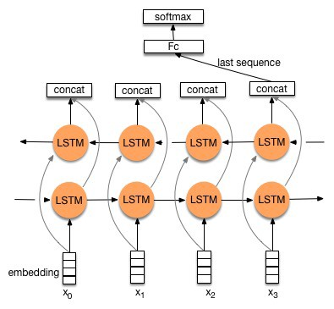
Practice 1: Sentiment Analysis
Setup Layer (Model)
Code
def build_model(self): fw_cell = rnn.DropoutWrapper(rnn.BasicLSTMCell(self.hidden_dim), output_keep_prob=self.keep_prob) bw_cell = rnn.DropoutWrapper(rnn.BasicLSTMCell(self.hidden_dim), output_keep_prob=self.keep_prob) output, (fw_state, bw_state) = tf.nn.bidirectional_dynamic_rnn( fw_cell, bw_cell, inputs=self.x_emb, sequence_length=self.x_len, dtype=tf.float32) text_vec = tf.concat([fw_state.h, bw_state.h], 1) out_W = self.get_var(name="out_W", shape=[self.hidden_dim*2, self.class_size]) out_b = self.get_var(name="out_b", shape=[self.class_size]) self.out = tf.nn.softmax(tf.matmul(text_vec, out_W) + out_b) self.out_label = tf.argmax(self.out, 1)

Slide 28
Practice 1: Sentiment Analysis
Result
Code
it: 3910 | loss: 0.173 | acc: 0.940 - 1089.83s
it: 3920 | loss: 0.057 | acc: 0.980 - 1092.30s
it: 3930 | loss: 0.133 | acc: 0.960 - 1094.51s
it: 3940 | loss: 0.106 | acc: 0.970 - 1096.41s
it: 3950 | loss: 0.134 | acc: 0.940 - 1098.33s
it: 3960 | loss: 0.024 | acc: 1.000 - 1100.24s
it: 3970 | loss: 0.111 | acc: 0.960 - 1102.13s
it: 3980 | loss: 0.079 | acc: 0.970 - 1104.00s
it: 3990 | loss: 0.016 | acc: 1.000 - 1105.92s
it: 4000 | loss: 0.051 | acc: 0.980 - 1107.80s
--> test_loss: 0.419 | test_acc: 1.000

